Slide 1
AUTOMATION FIRST
Evolve to a post-scarcity era
Alex Dragoi
Notes:
Friends and competitors
Why this title?
Raise your hand who has at the workplace and personal life

Slide 2
People
Time
S C
C I
A T
R Y
Money
Notes:
Raise your hand who has at the workplace and personal life
Limited resources compared to desires

Slide 3
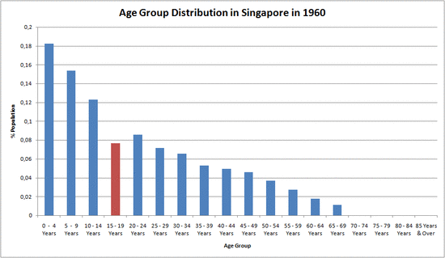
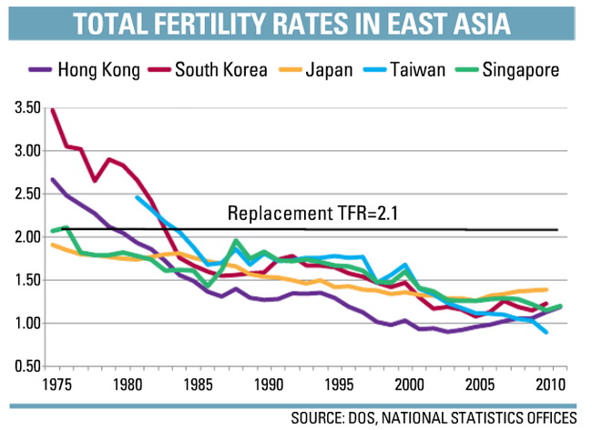
Average age ↗
Births rate ↘
Working Time →__
GDP growth ↗ ?
Notes:
Fertility rate decreasing in all developed countries
Working time at maximum stays the same
How to keep adding value?

Slide 4
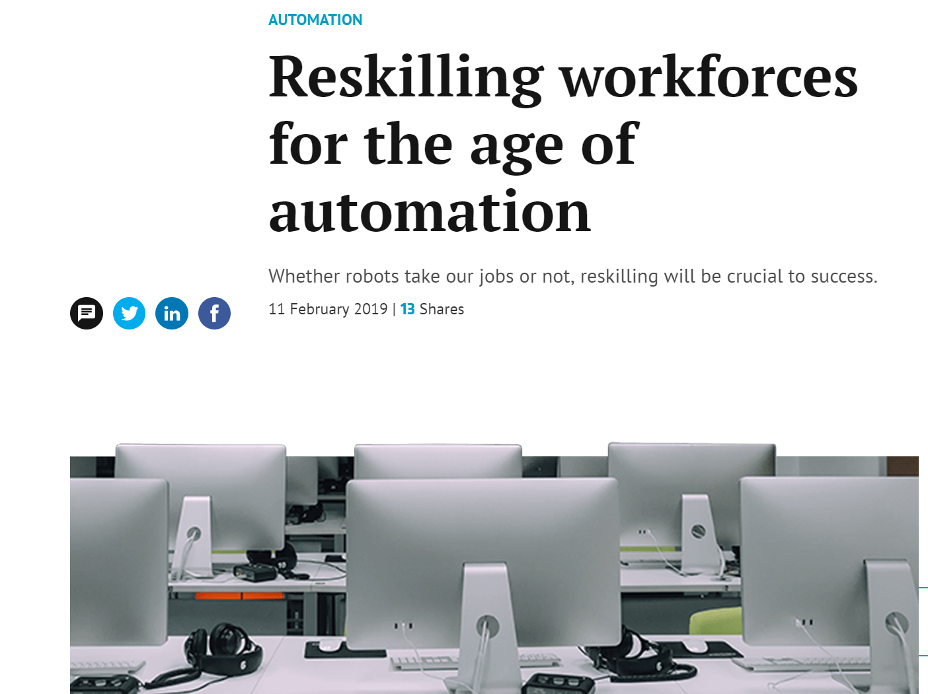

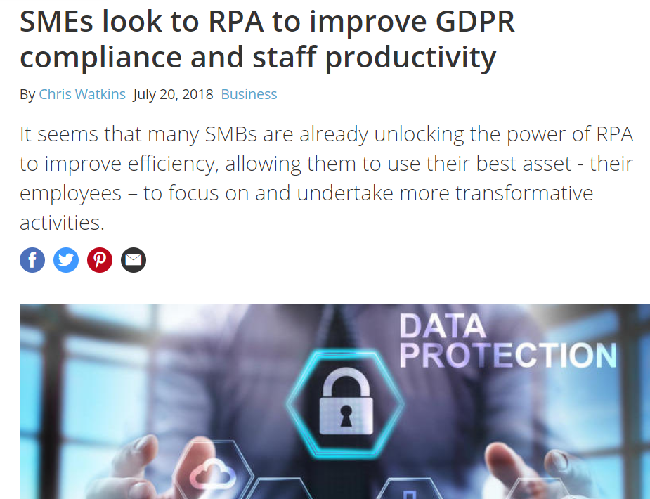
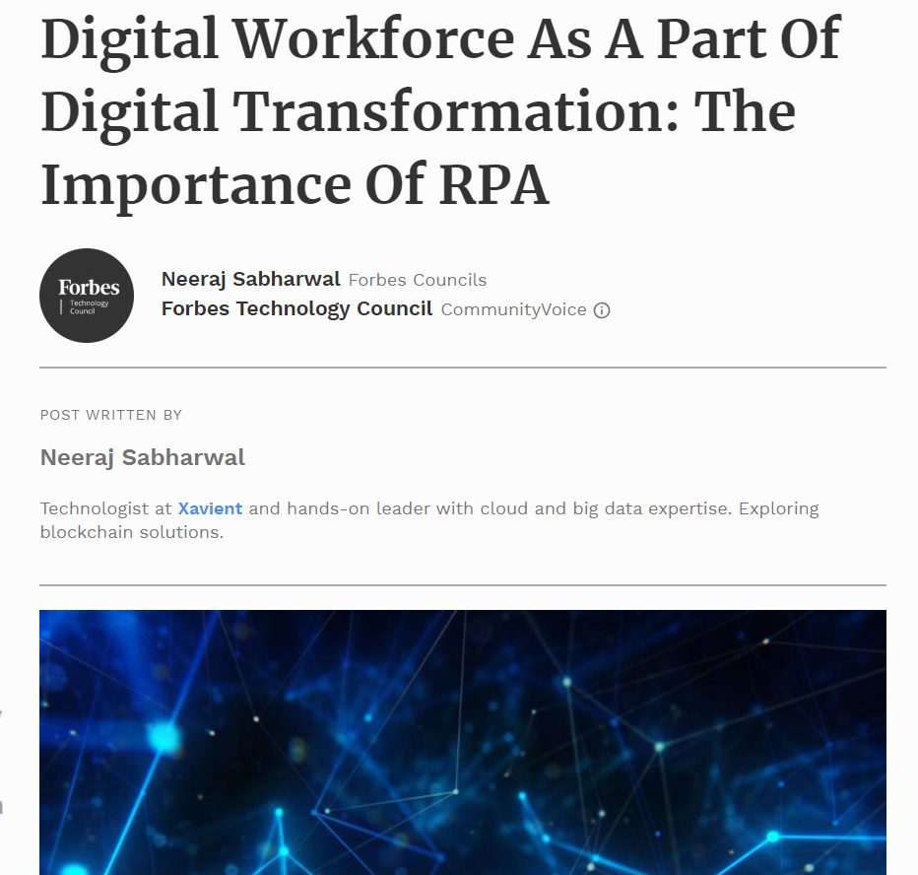
Notes:
Talk track: This breakthrough for SMBC is a breakthrough for Japan, where there have been few solutions to the aging crisis. Automation has the potential to solve bigger problems facing organizations (build with headlines?)​
Reskilling the Workforce​
Distributed Teams​
Privacy and Regulatory Shifts​
Digital Transformation

Slide 5
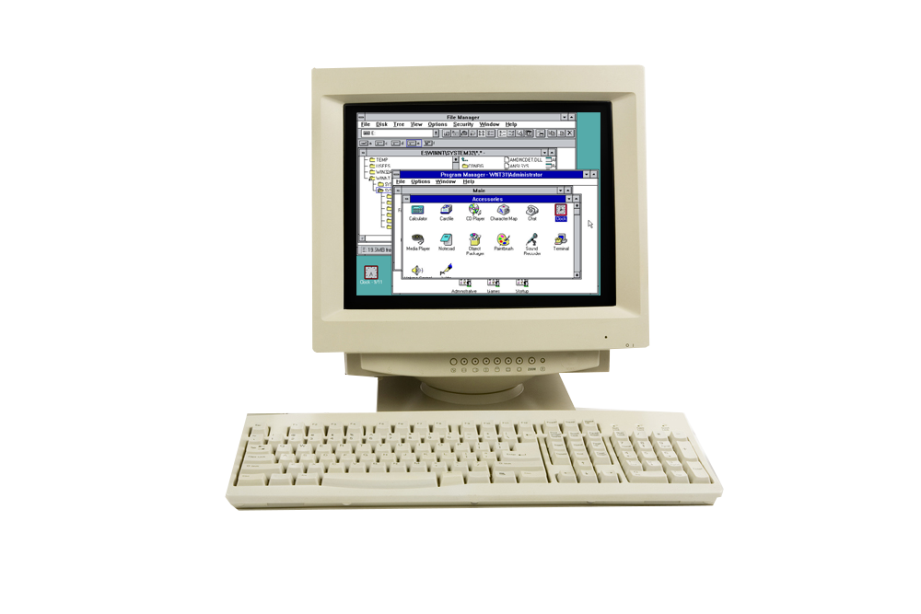
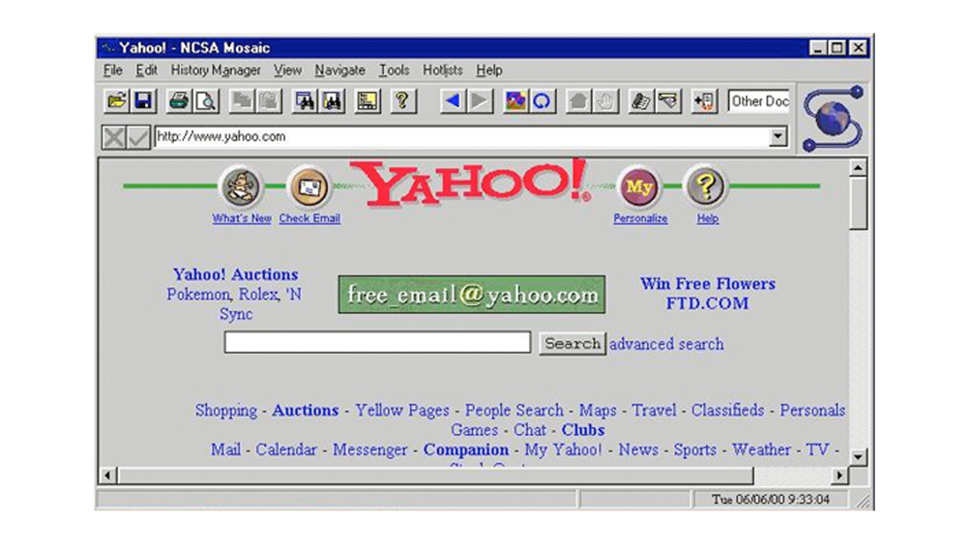
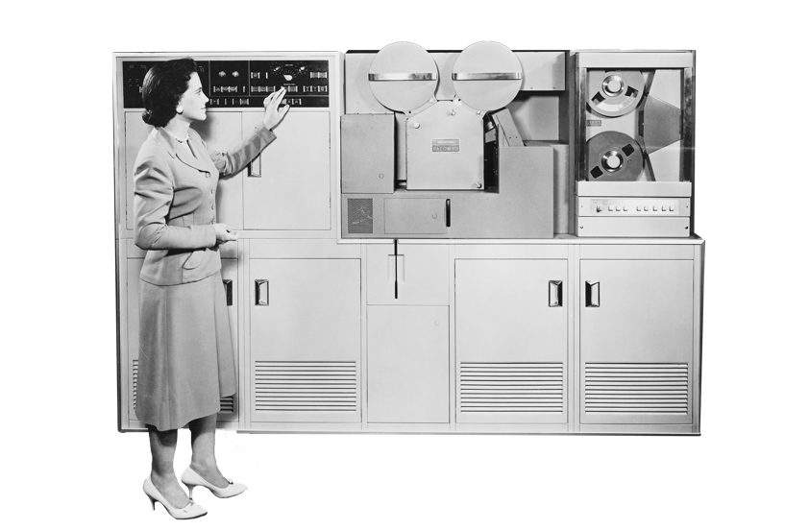
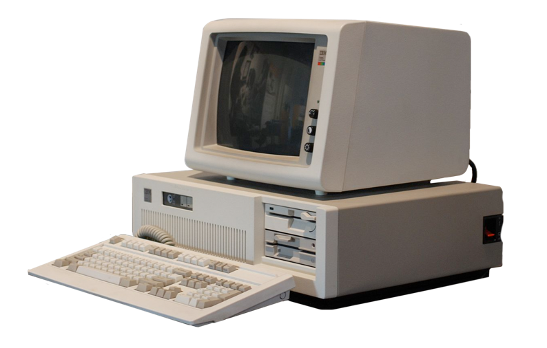


INNOVATION!
THE SIX ERAS OF ENTERPRISE TECHNOLOGY
MAINFRAME
PC
GUI
INTERNET
MOBILE
CLOUD
WHEN THESE NEW TECHNOLOGIES EMERGED, ENTERPRISES WENT ALL IN
Notes:
Invest the talent, time and money in innovation
Leap in productivity
Automation-first mindset
New business/operating model
Companies that embraced the new paradigm fully, thrived, the ones that didn’t disappeared quite fast

Slide 6



GLOBAL BENEFITS FROM AN AUTOMATION-FIRST MINDSET SUCCESS REQUIRES (HUMANS + ROBOTS)
75%
+50%
60 million
2.3 billion
Global productivity increases
Employee satisfaction increases
Automation creates net new jobs
Expands capacity
with full time equivalents
Notes:
Companies of today thrive when they use efficiently both humans and robots
Expanded capacity ---Mckinsey: A Future That Works: Automation, Employment, And Productivity
Global productivity improves ---- Source: McKinsey: A Future That Works: Automation, Employment, And Productivity
Post-scarcity
Increase the value of the human potential
New jobs created ---World Economic Forum, Future of Jobs Report
Satisfaction: Do what they like more: minesweeper
Mundane work becomes automated --- Deloitte: Automation is here to stay

Slide 7
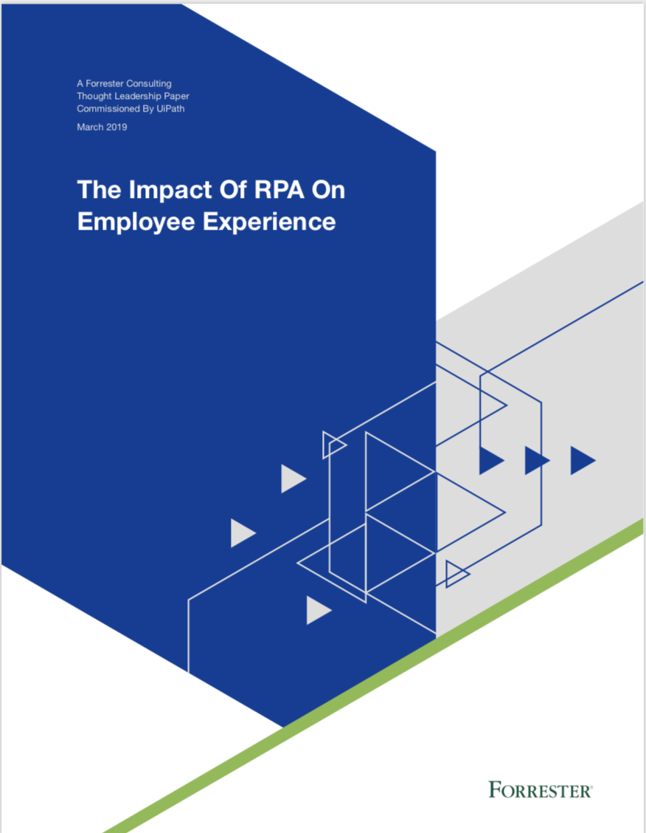
RPA LEADS TO INCREASINGLY ENGAGED EMPLOYEES
SUCCESS REQUIRES HUMANS + ROBOTS
Make it your aim to improve both operational efficiency and employee experience at the same time
Create a Robotic Operations Center (ROC); a best practice to scale automations enterprise-wide and ensure efficient maintenance
Manage psychological implications from the beginning; Ensure that people that want to have a path forward in your organization will have one
Use a human-centric change management process; ensure people feel valued and safe
92%
84%
80%
64%
Faster Efficiency
Better Customer Service
Higher Employee Engagement
Brand Boost

Slide 8


Slide 9
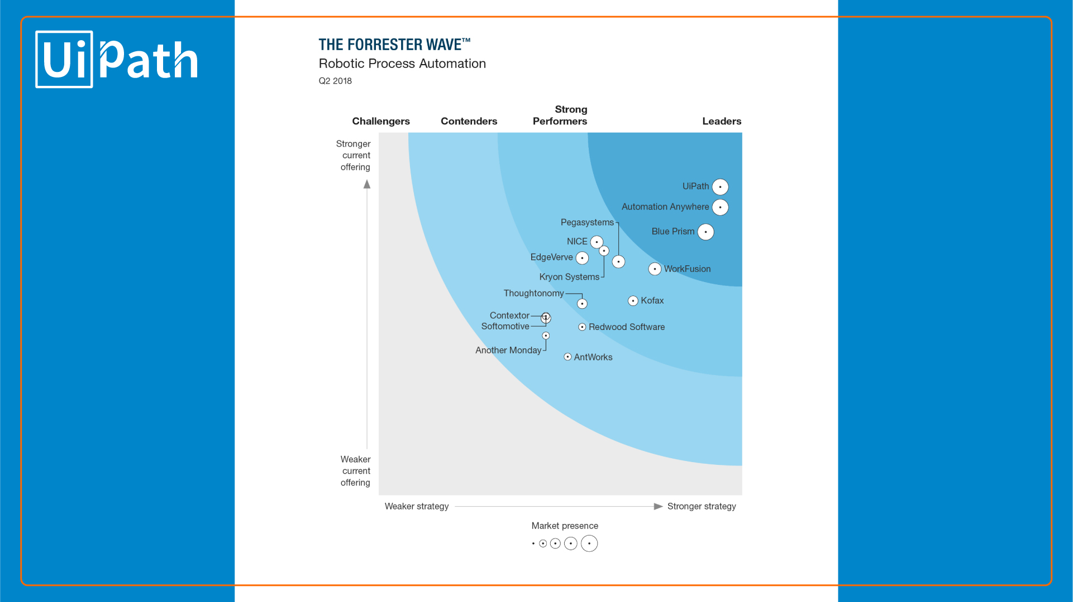

Latest Competitive Landscape
UiPath has been recognized as an RPA leader in the “Forrester Wave TM Robotic Process Automation, Q2 2018” report, reinforcing its position as the RPA provider with the strongest current capabilities.
UIPATH EARNS THE HIGHEST MARKET IMPACT
Latest Competitive Landscape
UiPath

Slide 10
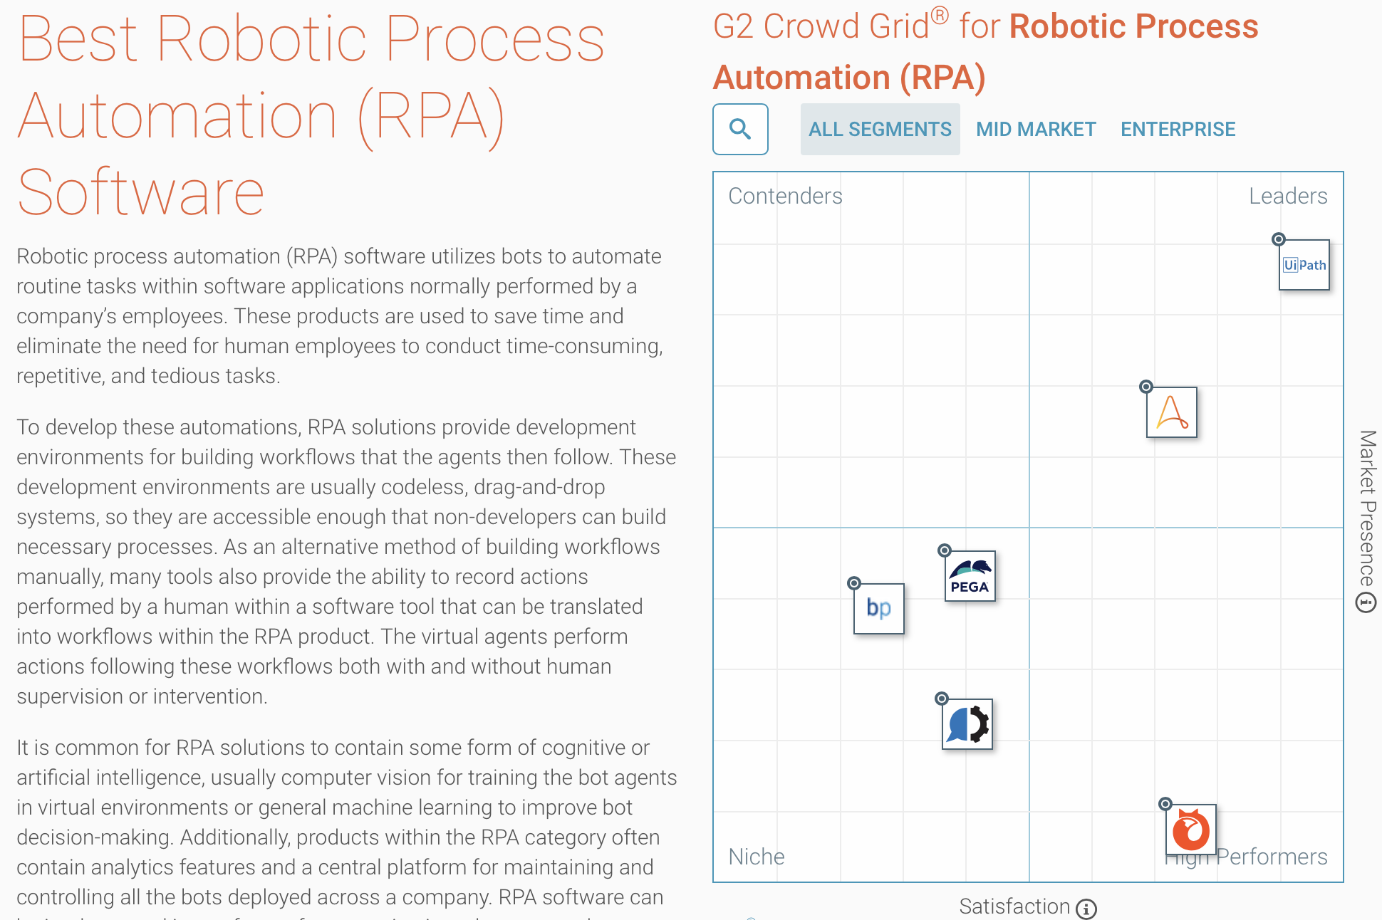
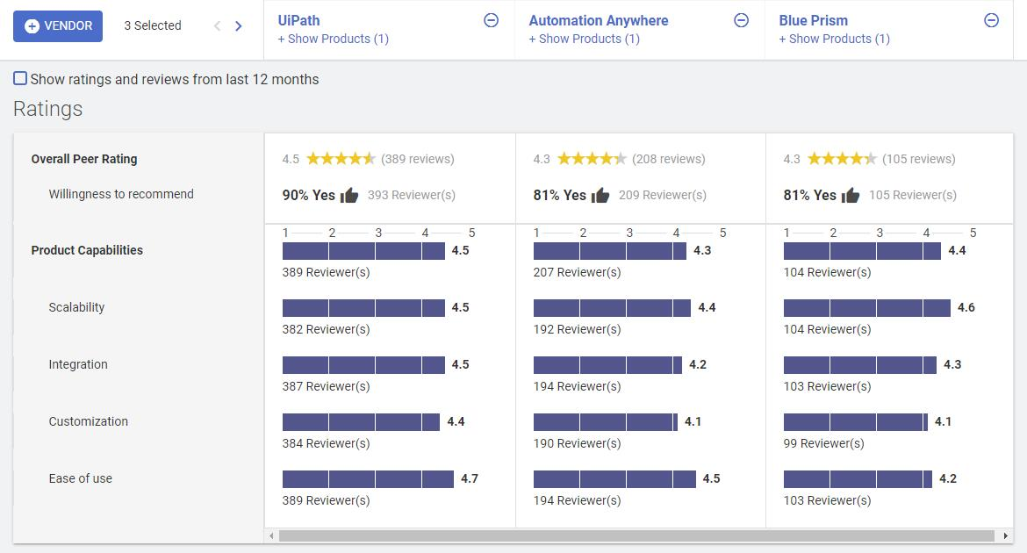
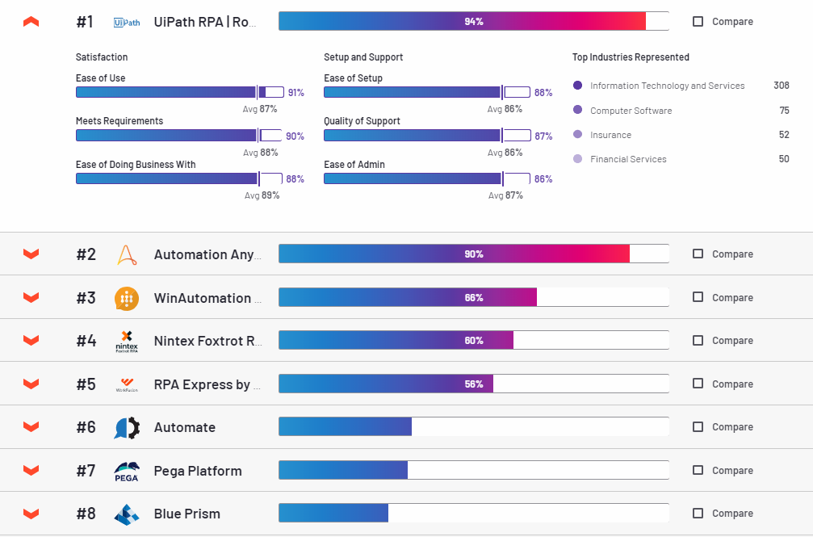
Notes:
Customers and users

Slide 11

HUMANS.
WE WERE MEANT TO BE CREATIVE
Robots do the tasks most of us hate doing anyway
Nobody misses the work robots are doing
¹ Forrester Research, January 2018: Enterprise RPA – The New Frontier of Automation
Notes:
Bali

Slide 12

“Once you give a person
their own robot and let them remove the mundane tasks from their day, this brings them joy. That person becomes more productive and creates more value for your enterprise
– Daniel Dines, CEO UiPath .”
Notes:
One robot for every person
Digital assistant that takes his admin tasks

Slide 13
Automation..
is not an investment in systems,
is an investment in People
Notes:
Companies that care about their employees

Slide 14

Notes:
This is why I joined UiPath, to first and foremost create a modern People team that is driving meaningful change
to create a next gen employee
experience and last be a part of something bigger than myself,
and be a part of a organization that is solving big problems and making work better for everyone.​
This is how we live, this is how we accelerate human potential

